Slide 1
Cut Performance Study
Pears

Slide 2
Attributes
Positive
Negative
Rarity (R)
Opportunity (O)
Optical performance (P)
Optical symmetry (S)
Face-up spread (Sp)
Face-up color grade difference (C)
Shape appeal (Sa)
Vulnerability to Chipping (D)
Fluorescence index (F)
Transparency index (T)
Non-pleasing optical phenomena (Np)
including
* Girdle Reflection under table, forming a
continuous ring
* Kozibe
* Culet (???)

Slide 3
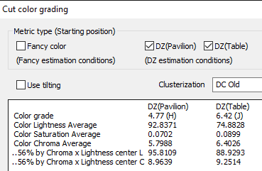
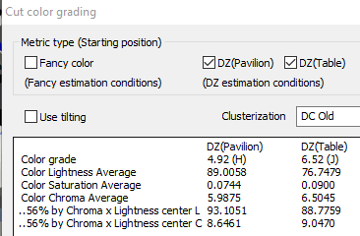
Pear – AJ-13.9_0.53 ct_H_VS1
Pear - BH1-31.23_0.51 ct_H_VVS1
Lab grade – H color
Face up color – J color
Lab grade – H color
Face up color – J color

Slide 4
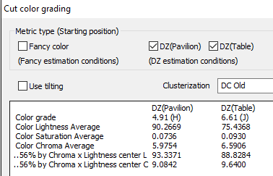
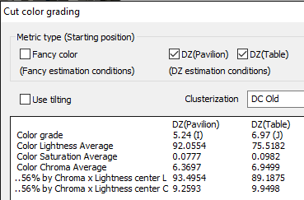
Pear – BQ6-165.1_0.52 ct_H_IF
Pear – BR12-37.3_0.52 ct_I_IF
Lab grade – H color
Face up color – J color
Lab grade – I color
Face up color – J color

Slide 5
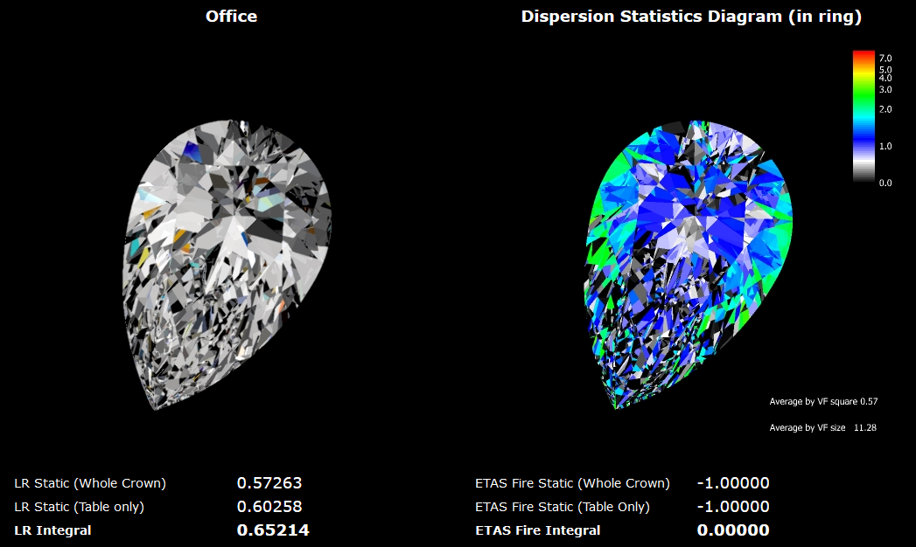

Slide 6
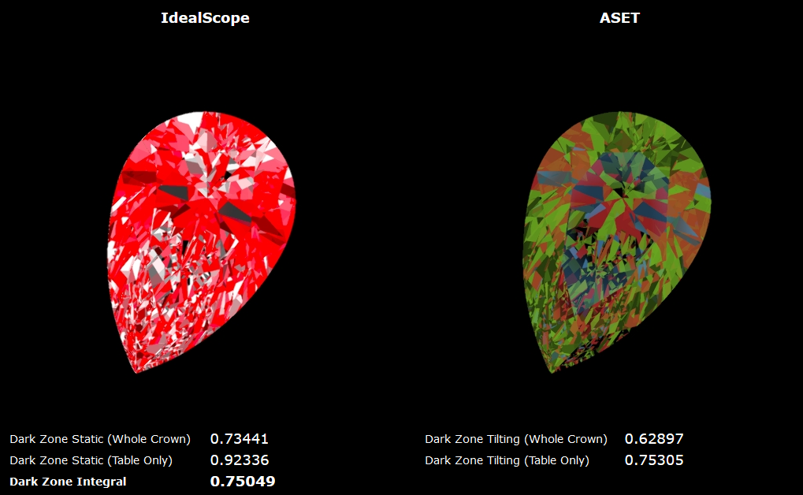

Slide 7
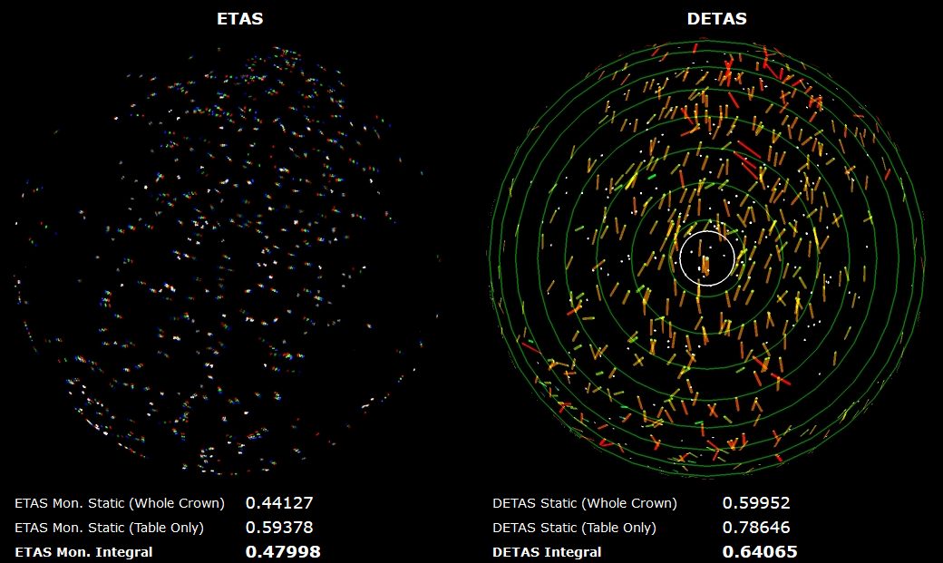

Slide 8
Price Index Formula
Price of a polish
α Rarity (R)
α Opportunity (O)
α Optical Performance (P)
α Optical Symmetry (S)
α Face-up spread (Sp %)
α Face-up color grade difference (C)
α Shape appeal index (Sa)
1/α Vulnerability index (D)
1/α Fluorescence index (F)
1/α Transparency index (T)
1/α Non-pleasing index (Np)
Price of a polish /
Price of same color - clarity – weight ideal RBC
= (1+R)^a * (1+O)^b * (1+P)^c * ((5+S)/5)^d *
(1+Sp/100)^e * ((23+C)/23)^f * (1+Sa)^g *
(1+D)^-h * (1+F)^-j * (1+T)^-k * (1+Np)^-m
Where, a, b, c, d, e, f, g, h, j, k and m are power index

